Slide 1
Instrument Control Requirements
Date: 12-05-2024
Ability to set joint limits in individual instruments
Independent scaling factors for instruments in orientation and grip
Roll
Pitch
Yaw
Grip open
Grip closing angle
Model and tool frame and “hand control” according to instrument
Instrument control logic and parameters (Yaw, Pitch & Grip) independent of actuators (separate parameters depending upon actuator to achieve the motion and force requirements)

Slide 2
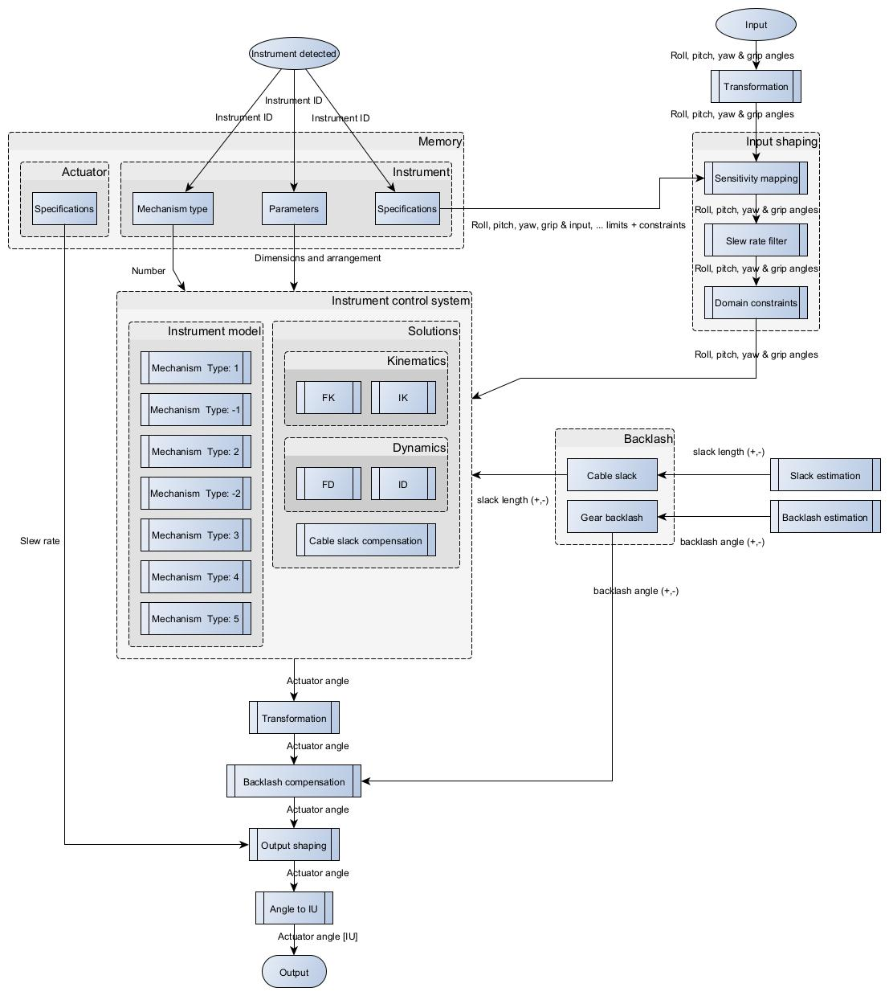
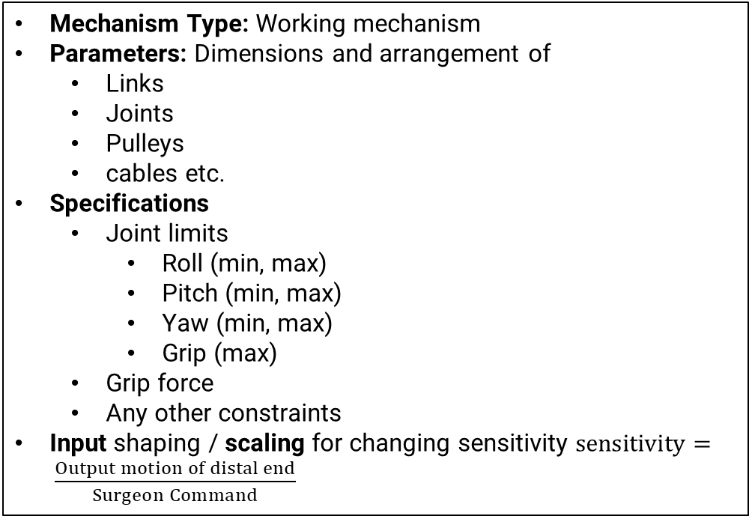
Inverse Kinematics Flow Chart (Process Output): For calculating actuator commands.
Mechanism Type: Working mechanism
Parameters: Dimensions and arrangement of
Links
Joints
Pulleys
cables etc.
Specifications
Joint limits
Roll (min, max)
Pitch (min, max)
Yaw (min, max)
Grip (max)
Grip force
Any other constraints
Input shaping / scaling for changing sensitivity $sensitivity= \frac{Output motion of distal end}{Surgeon Command}$

Slide 3
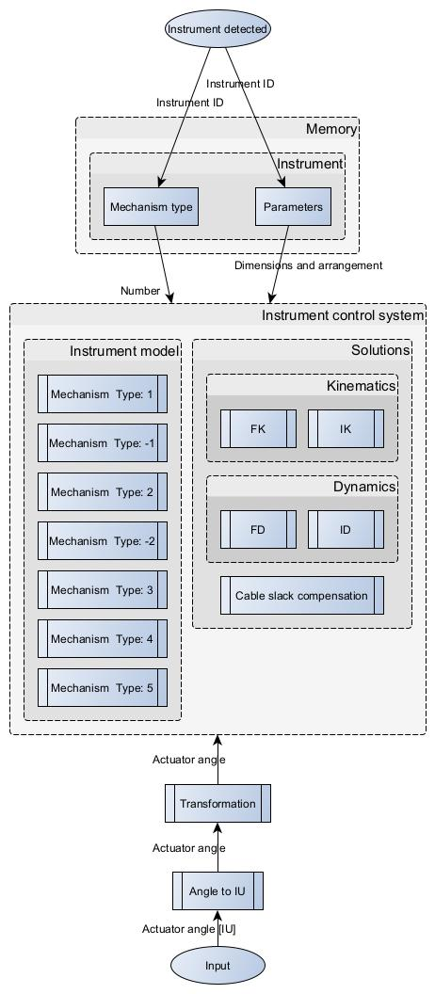
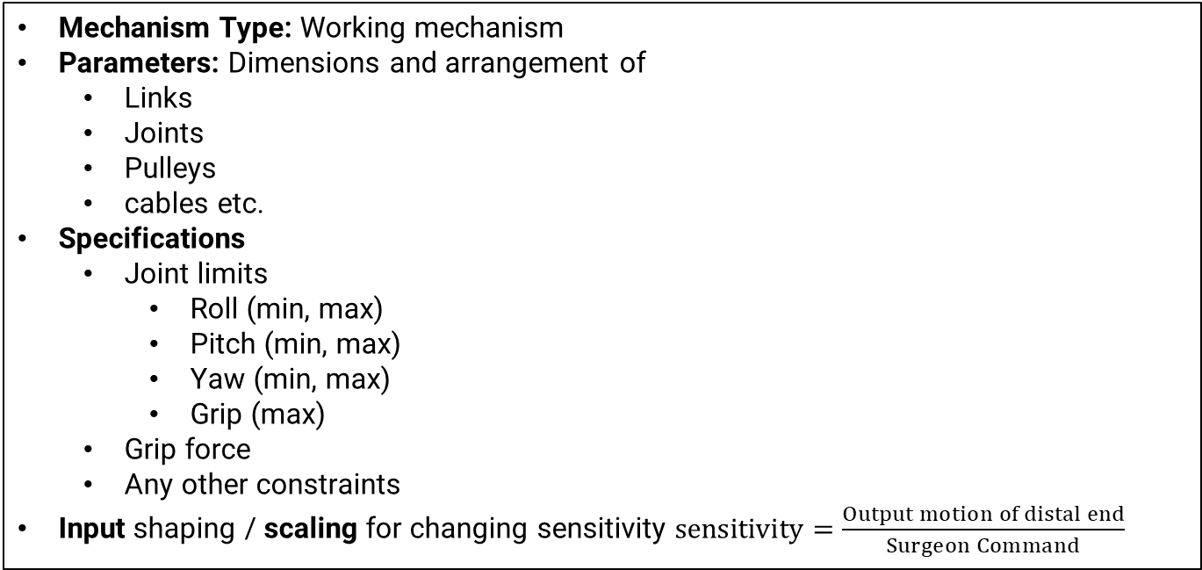
Forward Kinematics Flow Chart (Process Input): For Visualization and feedback, during disable / enable
Mechanism Type: Working mechanism
Parameters: Dimensions and arrangement of
Links
Joints
Pulleys
cables etc.
Specifications
Joint limits
Roll (min, max)
Pitch (min, max)
Yaw (min, max)
Grip (max)
Grip force
Any other constraints
Input shaping / scaling for changing sensitivity $sensitivity=\frac{Output motion of distal end}{Surgeon Command}$

Slide 4
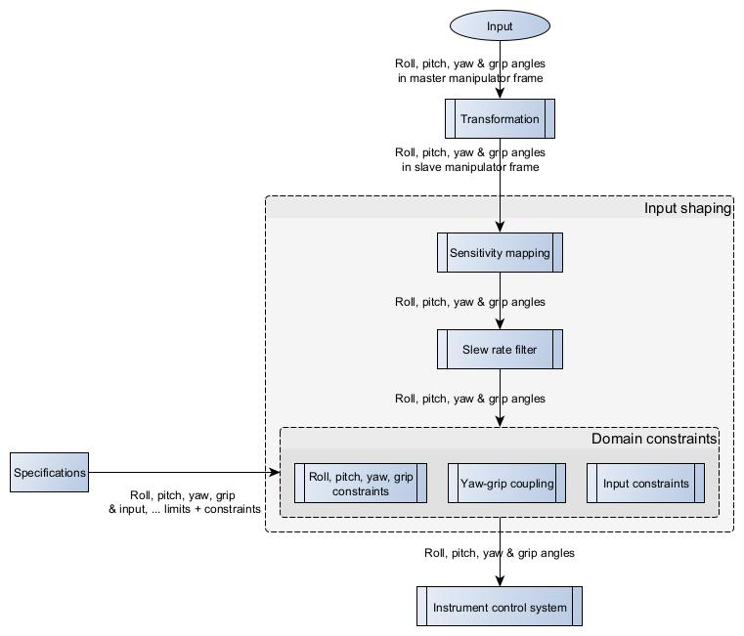
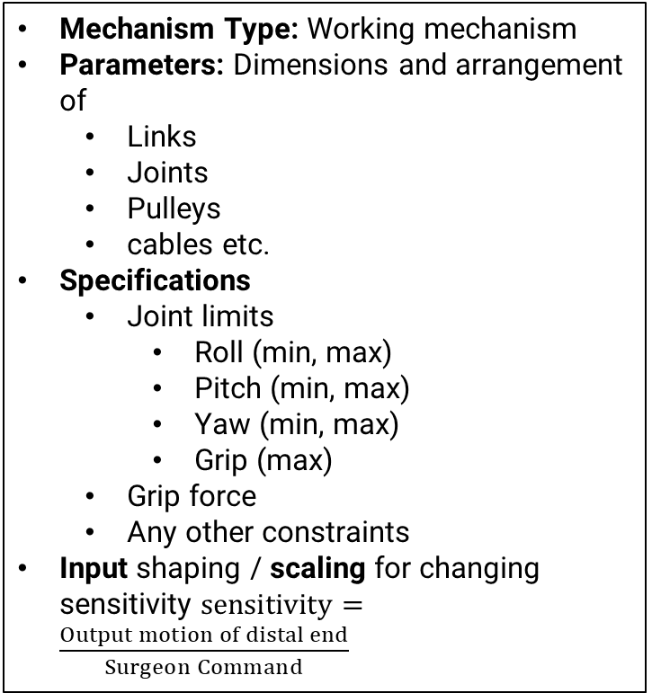
Input Shaping Flow Chart (Process Output & Input) : For Limiting, scaling / manipulating user command
Mechanism Type: Working mechanism
Parameters: Dimensions and arrangement of
Links
Joints
Pulleys
cables etc.
Specifications
Joint limits
Roll (min, max)
Pitch (min, max)
Yaw (min, max)
Grip (max)
Grip force
Any other constraints
Input shaping / scaling for changing sensitivity $sensitivity=\frac{Output motion of distal end}{Surgeon Command}$

Slide 5
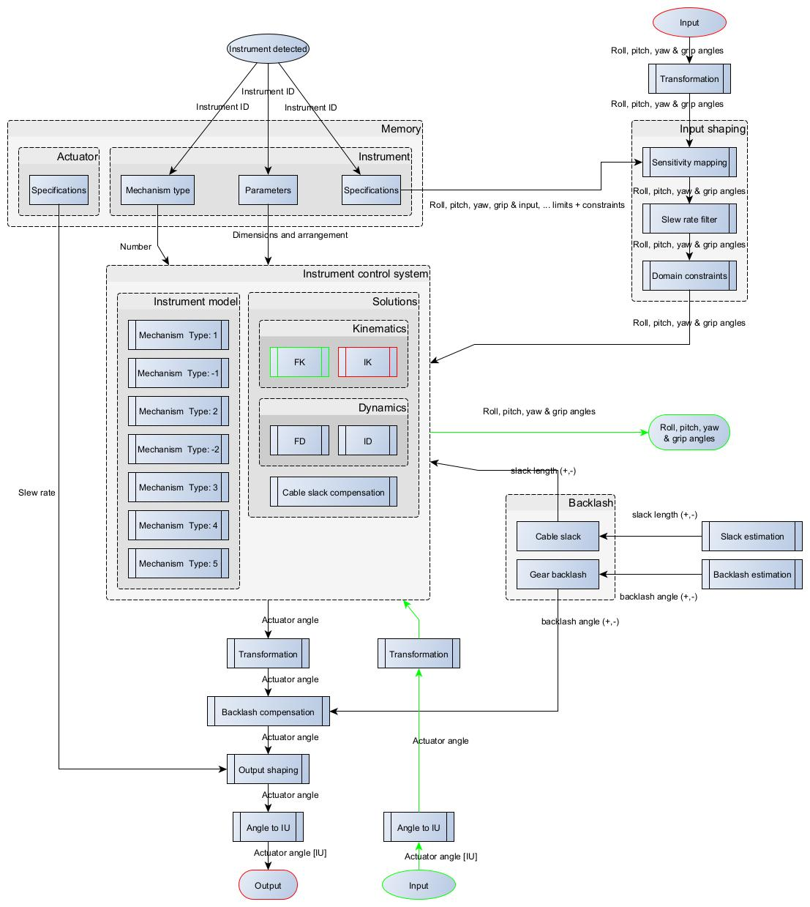
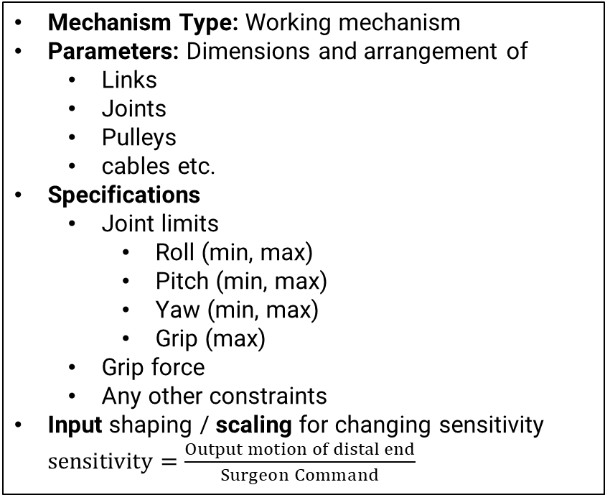
Instrument Control Flow Chart
Mechanism Type: Working mechanism
Parameters: Dimensions and arrangement of
Links
Joints
Pulleys
cables etc.
Specifications
Joint limits
Roll (min, max)
Pitch (min, max)
Yaw (min, max)
Grip (max)
Grip force
Any other constraints
Input shaping / scaling for changing sensitivity $sensitivity=\frac{Output motion of distal end}{Surgeon Command}$

